Slide 1
AUSTRALIA’S ICONIC WINE ESTATE

Slide 2
Located in on the western ridge of the Barossa, 1 hour north from the capital city Adelaide, South Australia

Slide 3
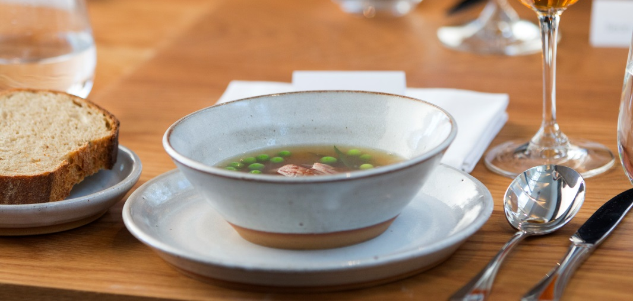
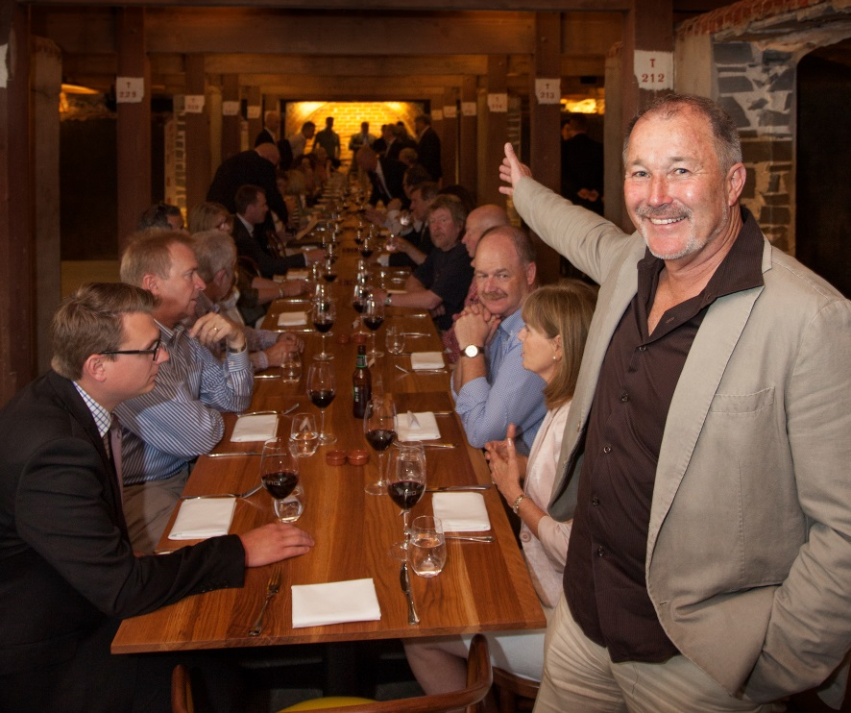
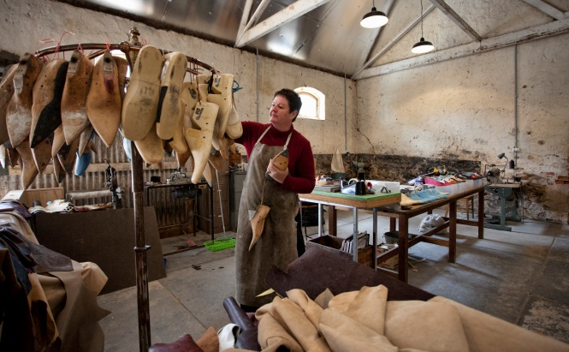
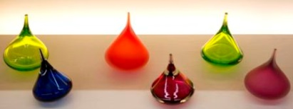
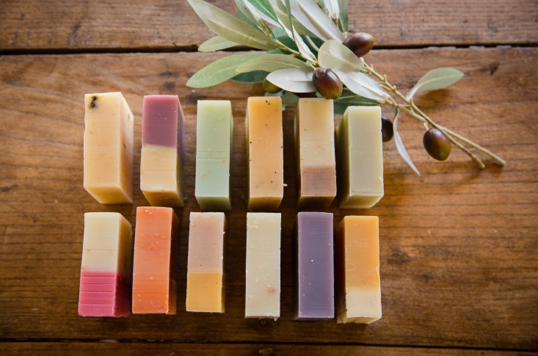
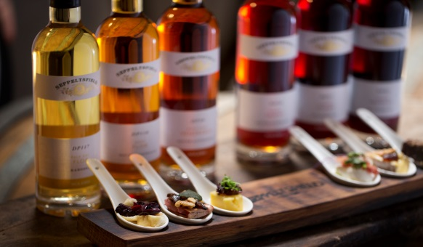
BAROSSA WINE, FOOD, CRAFT, DESIGN & BEAUTY
Gourmet Traveller WINE – Star Cellar Door 6 times - 2015-2020
2016, 2018 & 2019 Tourism Winery Winner – South Australia
Destination Restaurant - FINO
Craft & Design Studios – JamFactory
Vasse Virgin Skin Care
Segway Tours
Owen Andrews Events
Cooperage (barrel making)

Slide 4
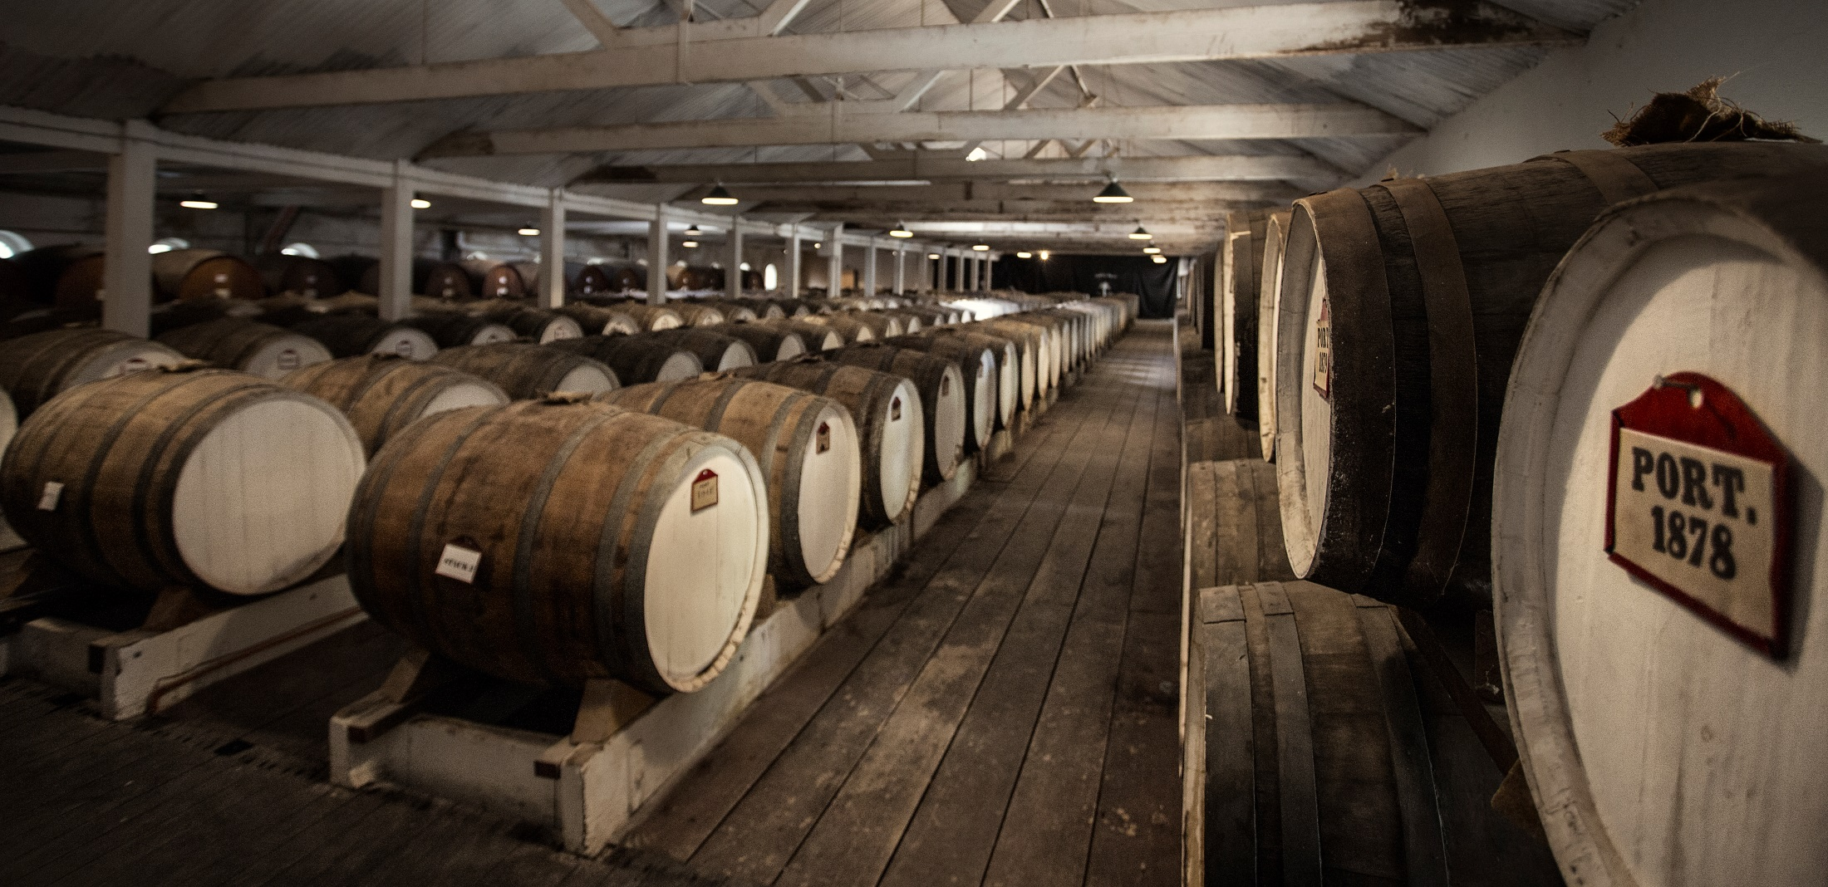
Experiences
Longest lineage of wine in barrel, dating back to 1878
Centennial Cellar – suite of tasting options
Taste Your Birth Year
“The most historic winery & greatest show piece of the Barossa Valley” James Halliday

Slide 5
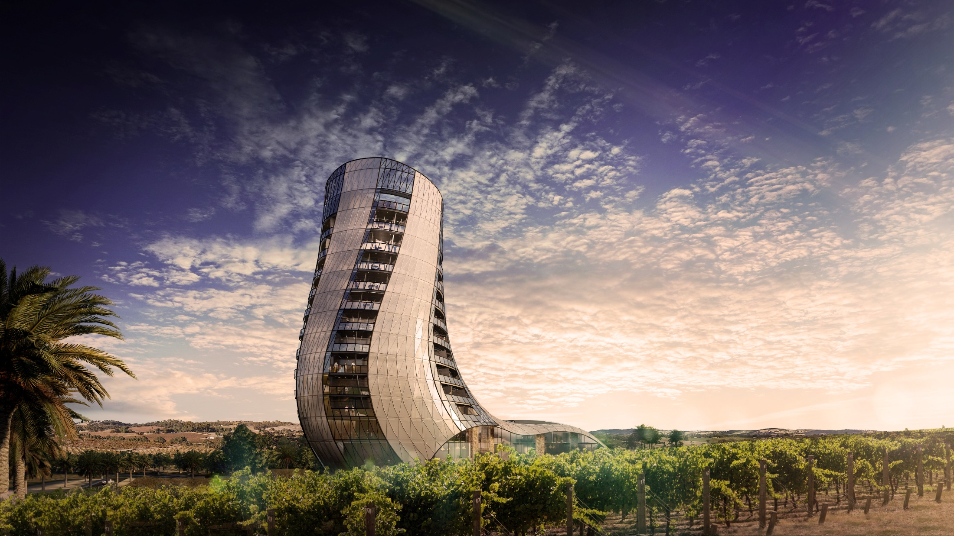
COMING SOON…..
Oscar Seppeltsfield
5+ star 70 room Luxury Accommodation

Slide 6
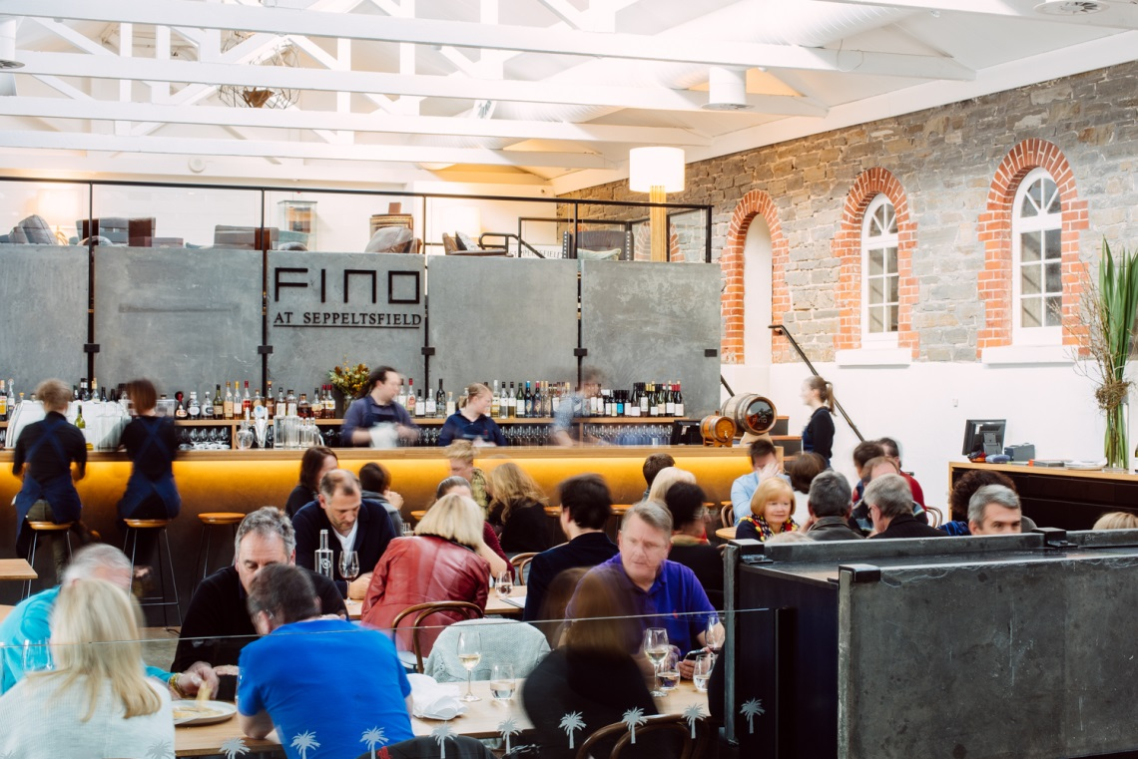
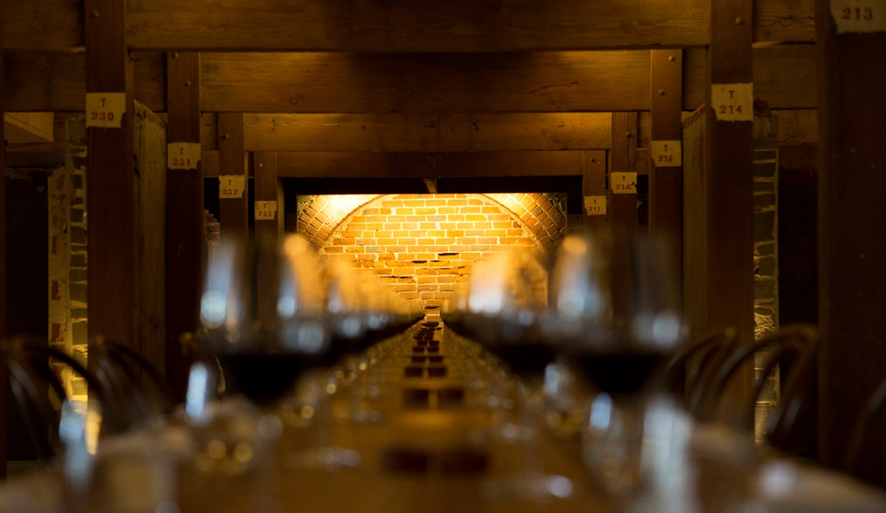
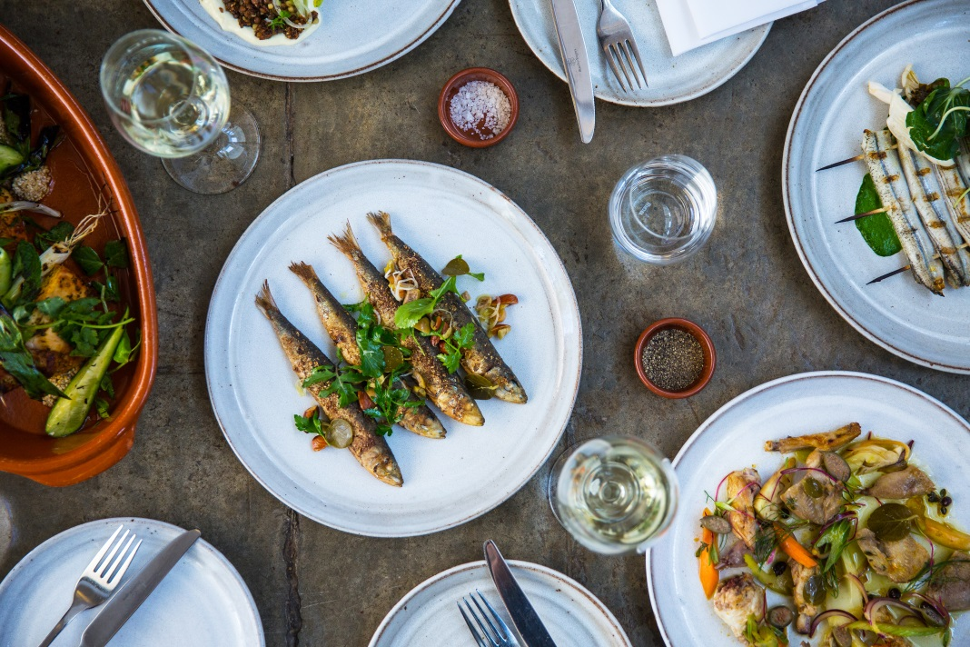
FINO SEPPELTSFIELD
Award winning Regional Destination Restaurant

Slide 7
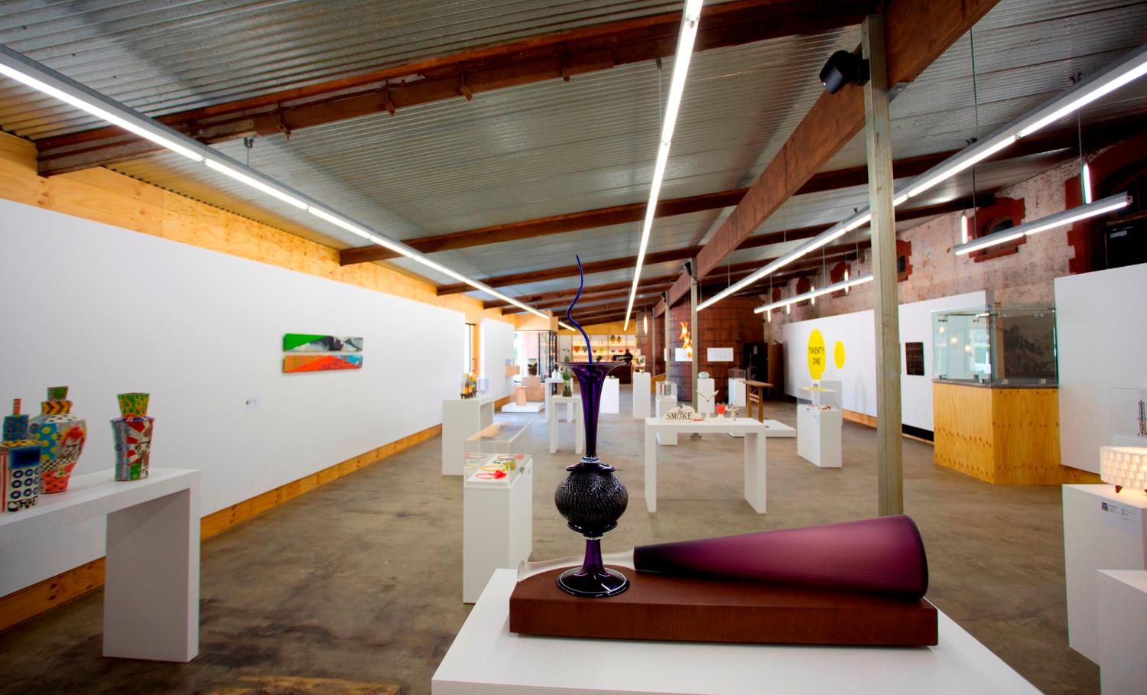
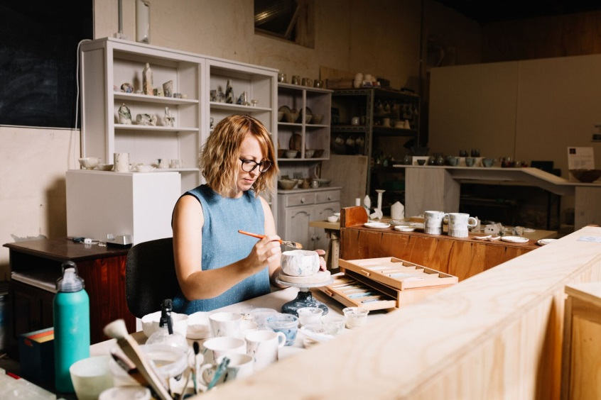
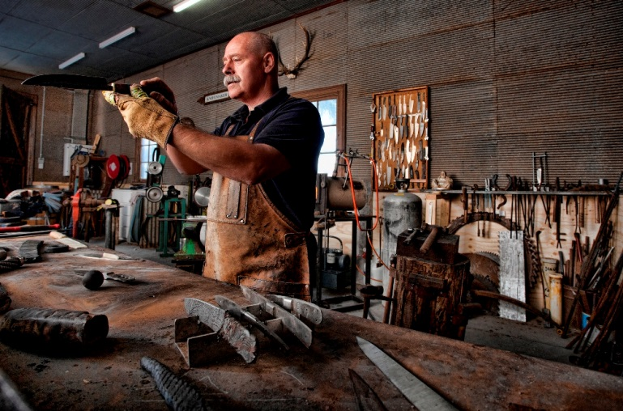
JAMFACTORY SEPPELTSFIELD
Art & Design, 7 Artisans Studios & Workshops

Slide 8
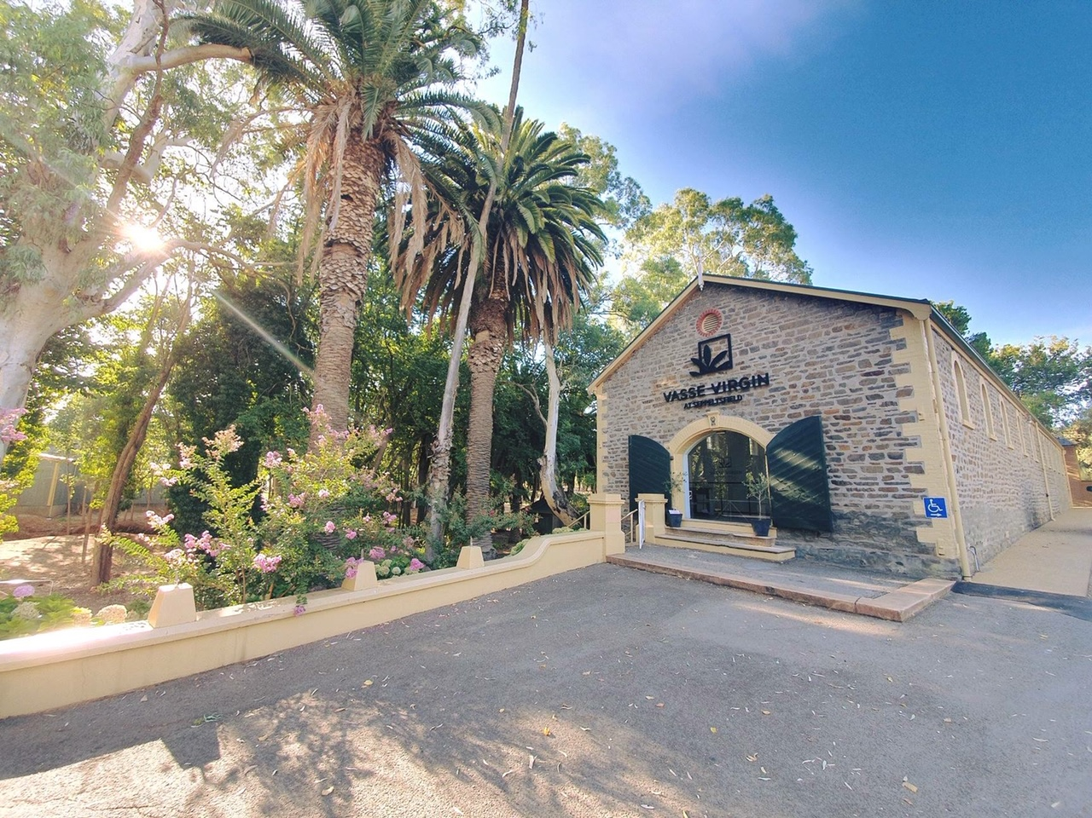
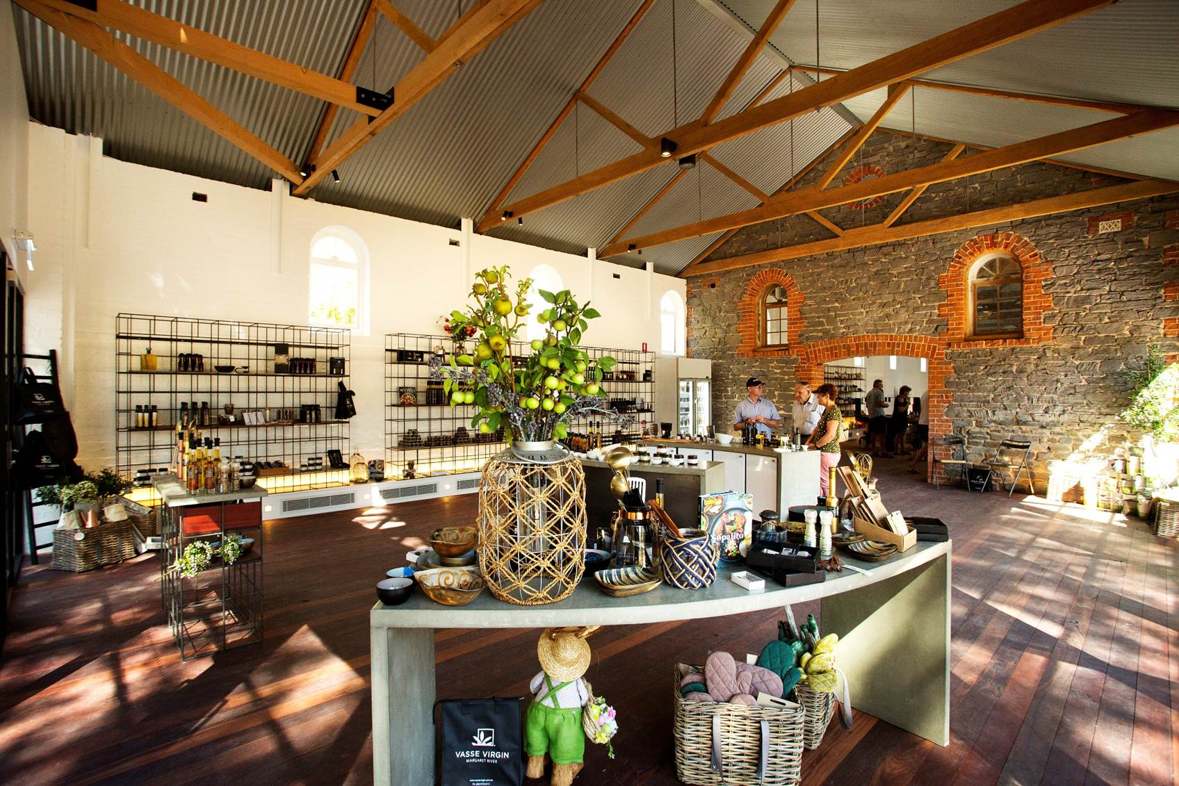
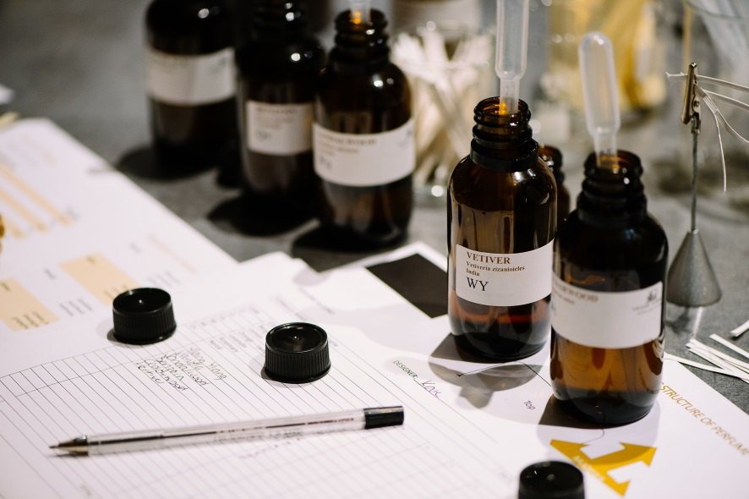

Slide 9
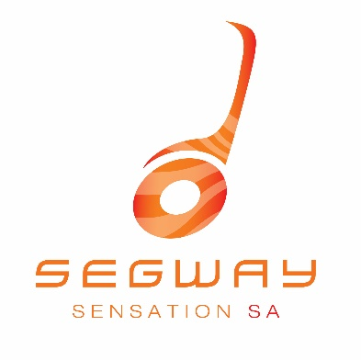
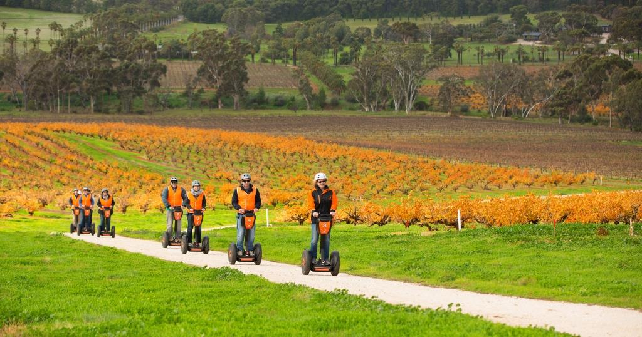
SEGWAY SENSATIONS SA SEPPELTSFIELD

Slide 10
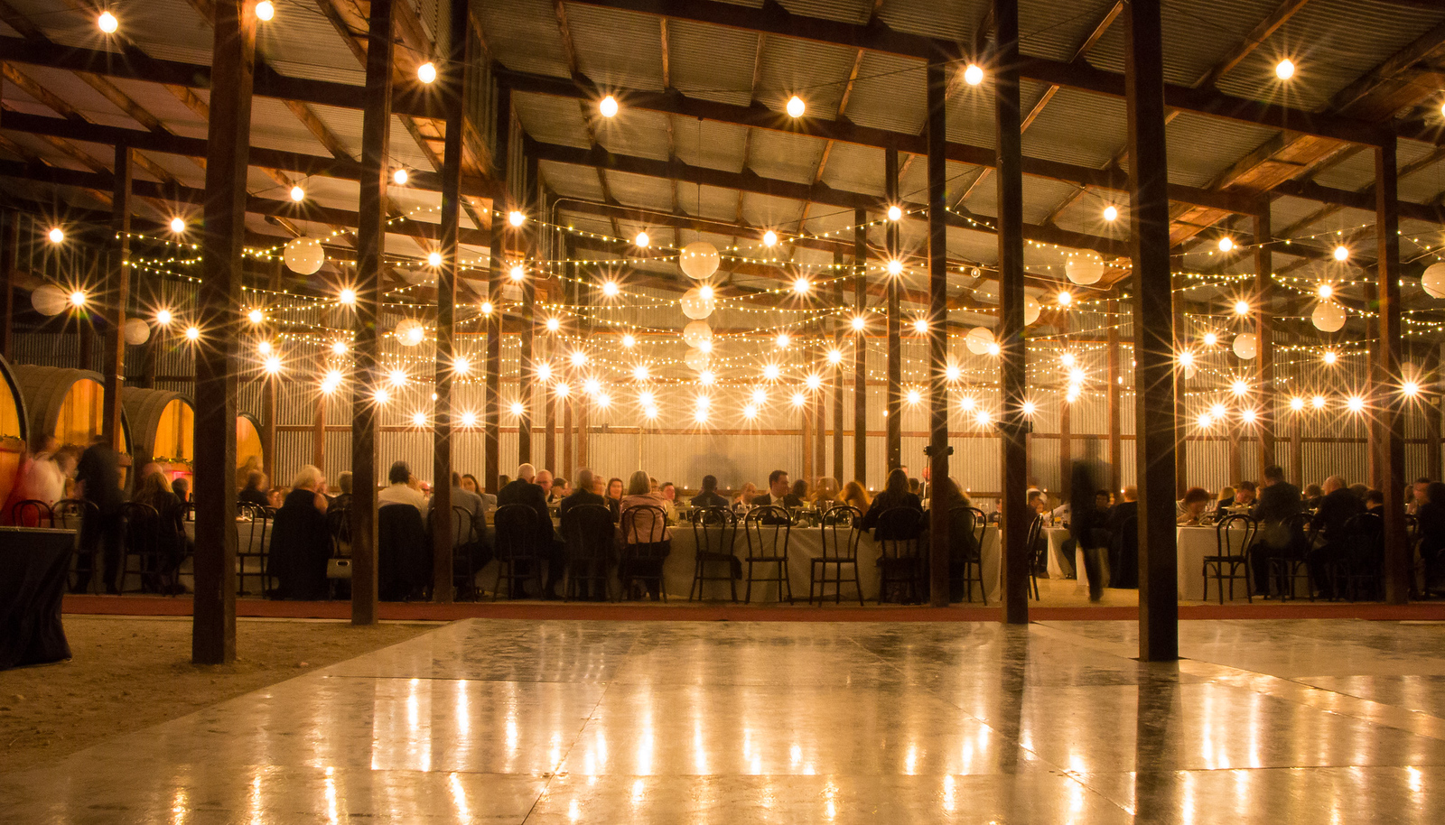
OWEN ANDREWS
Award winning Chef
Functions & Events at SEPPELTSFIELD

Slide 11
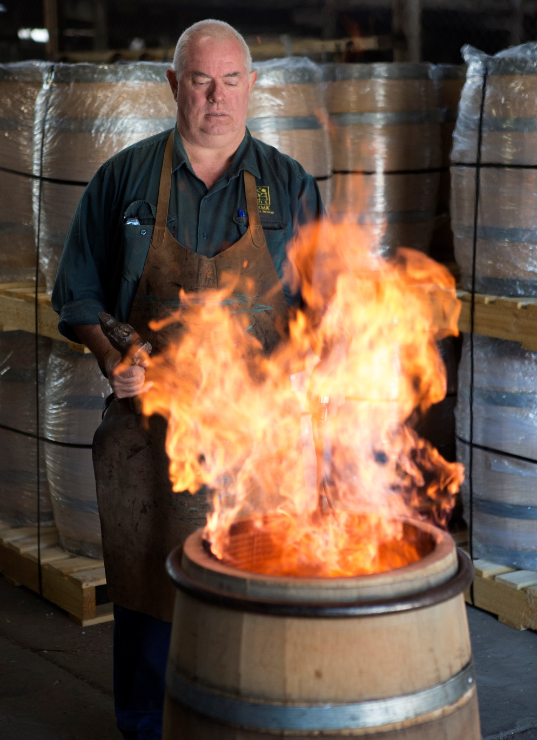
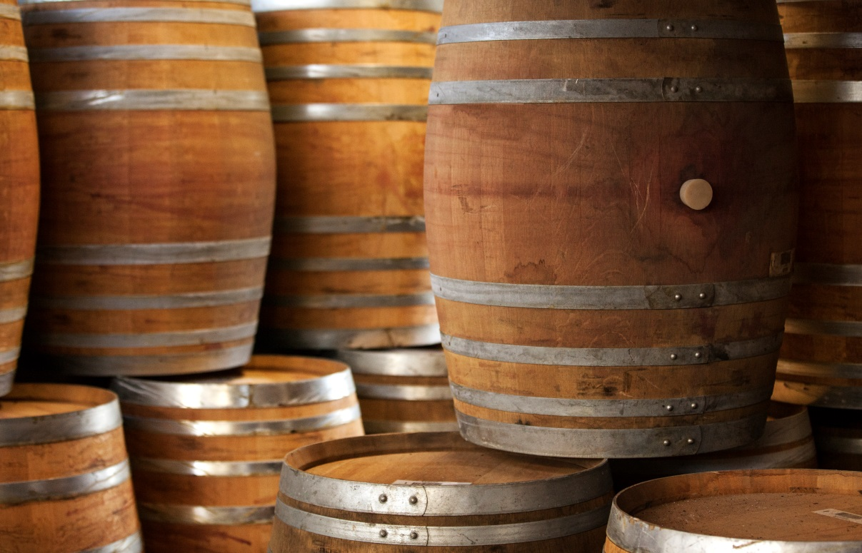
WORKING COOPERAGE SEPPELTSFIELD
Andrew Young – Master Cooper
Cooper for a Day

Slide 12
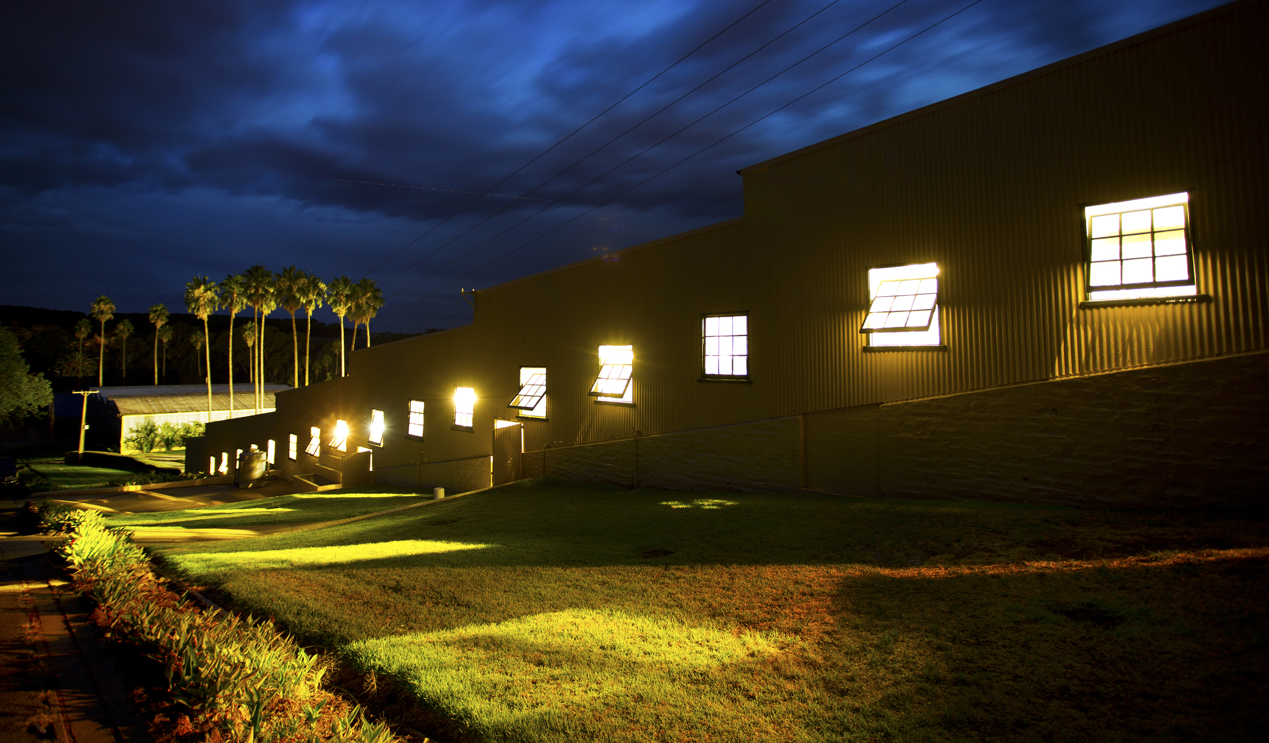
1888 Gravity flow winery
Crushes 5,000 tonnes = 35million litres of wine

Slide 13
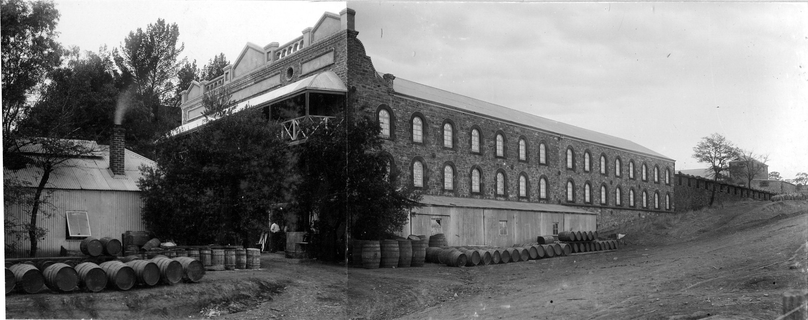
HISTORY & HERITAGE
13 State Heritage Listed buildings
Blending Cellar 1870’s

Slide 14
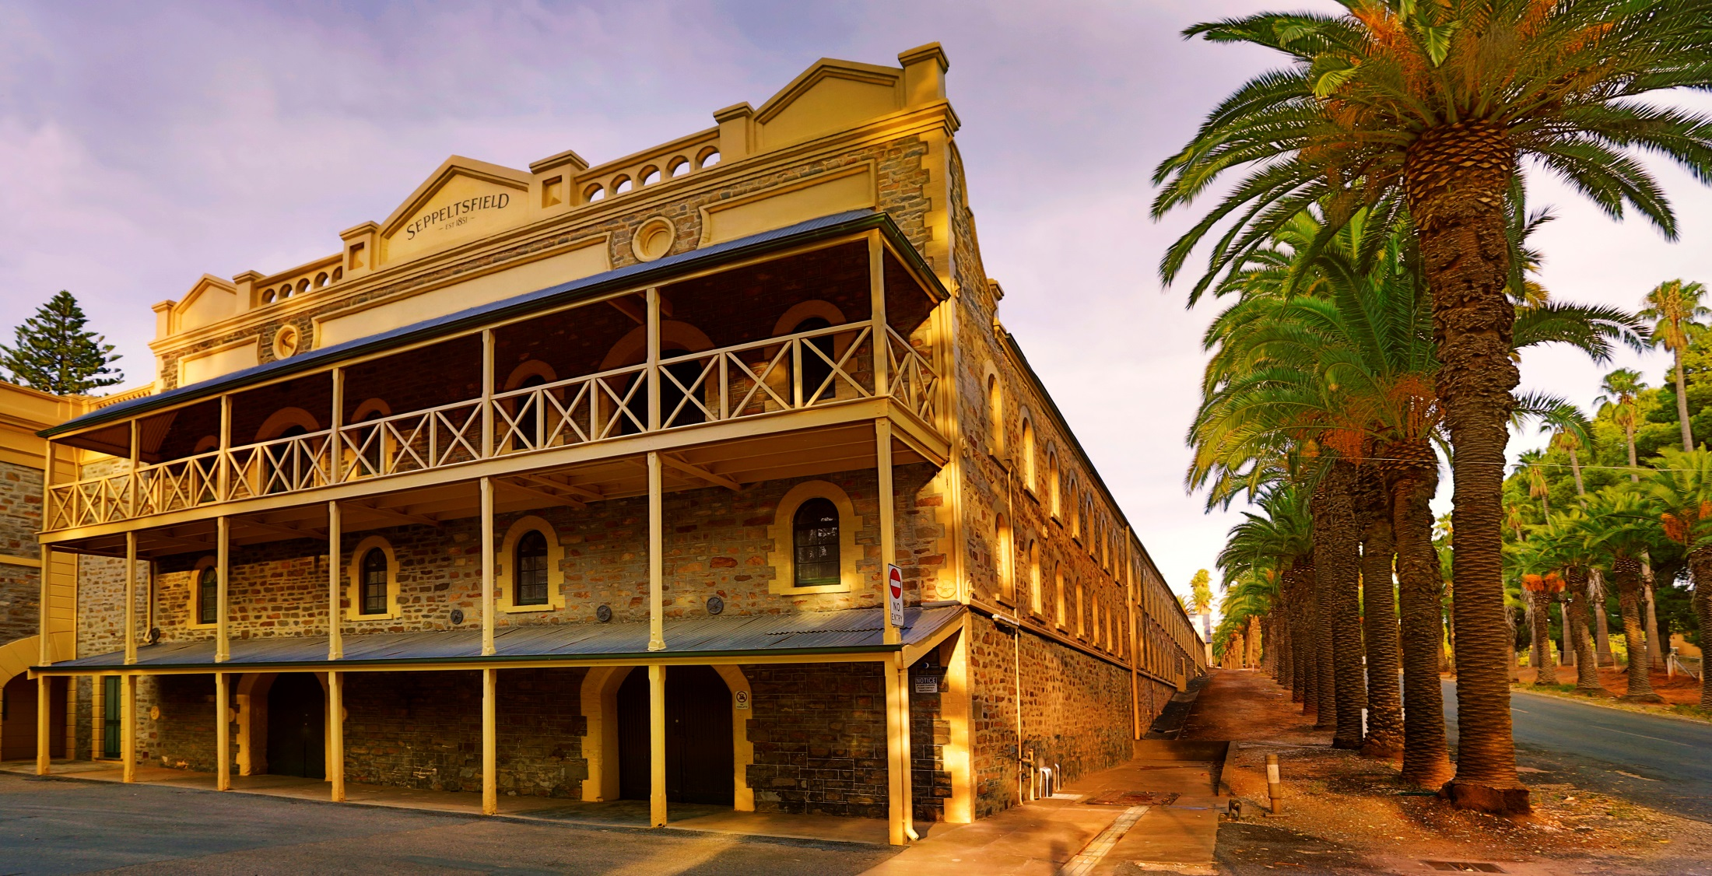
HISTORY & HERITAGE
13 State Heritage Listed buildings
Blending Cellar today

Slide 15
Thank you
Nicole Hodgson
Head of Tourism & Stakeholder Relations

