Slide 1
LUXURY CULINARY RETREAT

Slide 2
BAROSSA VALLEY, SOUTH AUSTRALIA
GETTING HERE
1 hour ground transport or 20 minute helicopter flight from Adelaide International and Domestic Airport

Slide 3
15 Private Suites

Slide 4
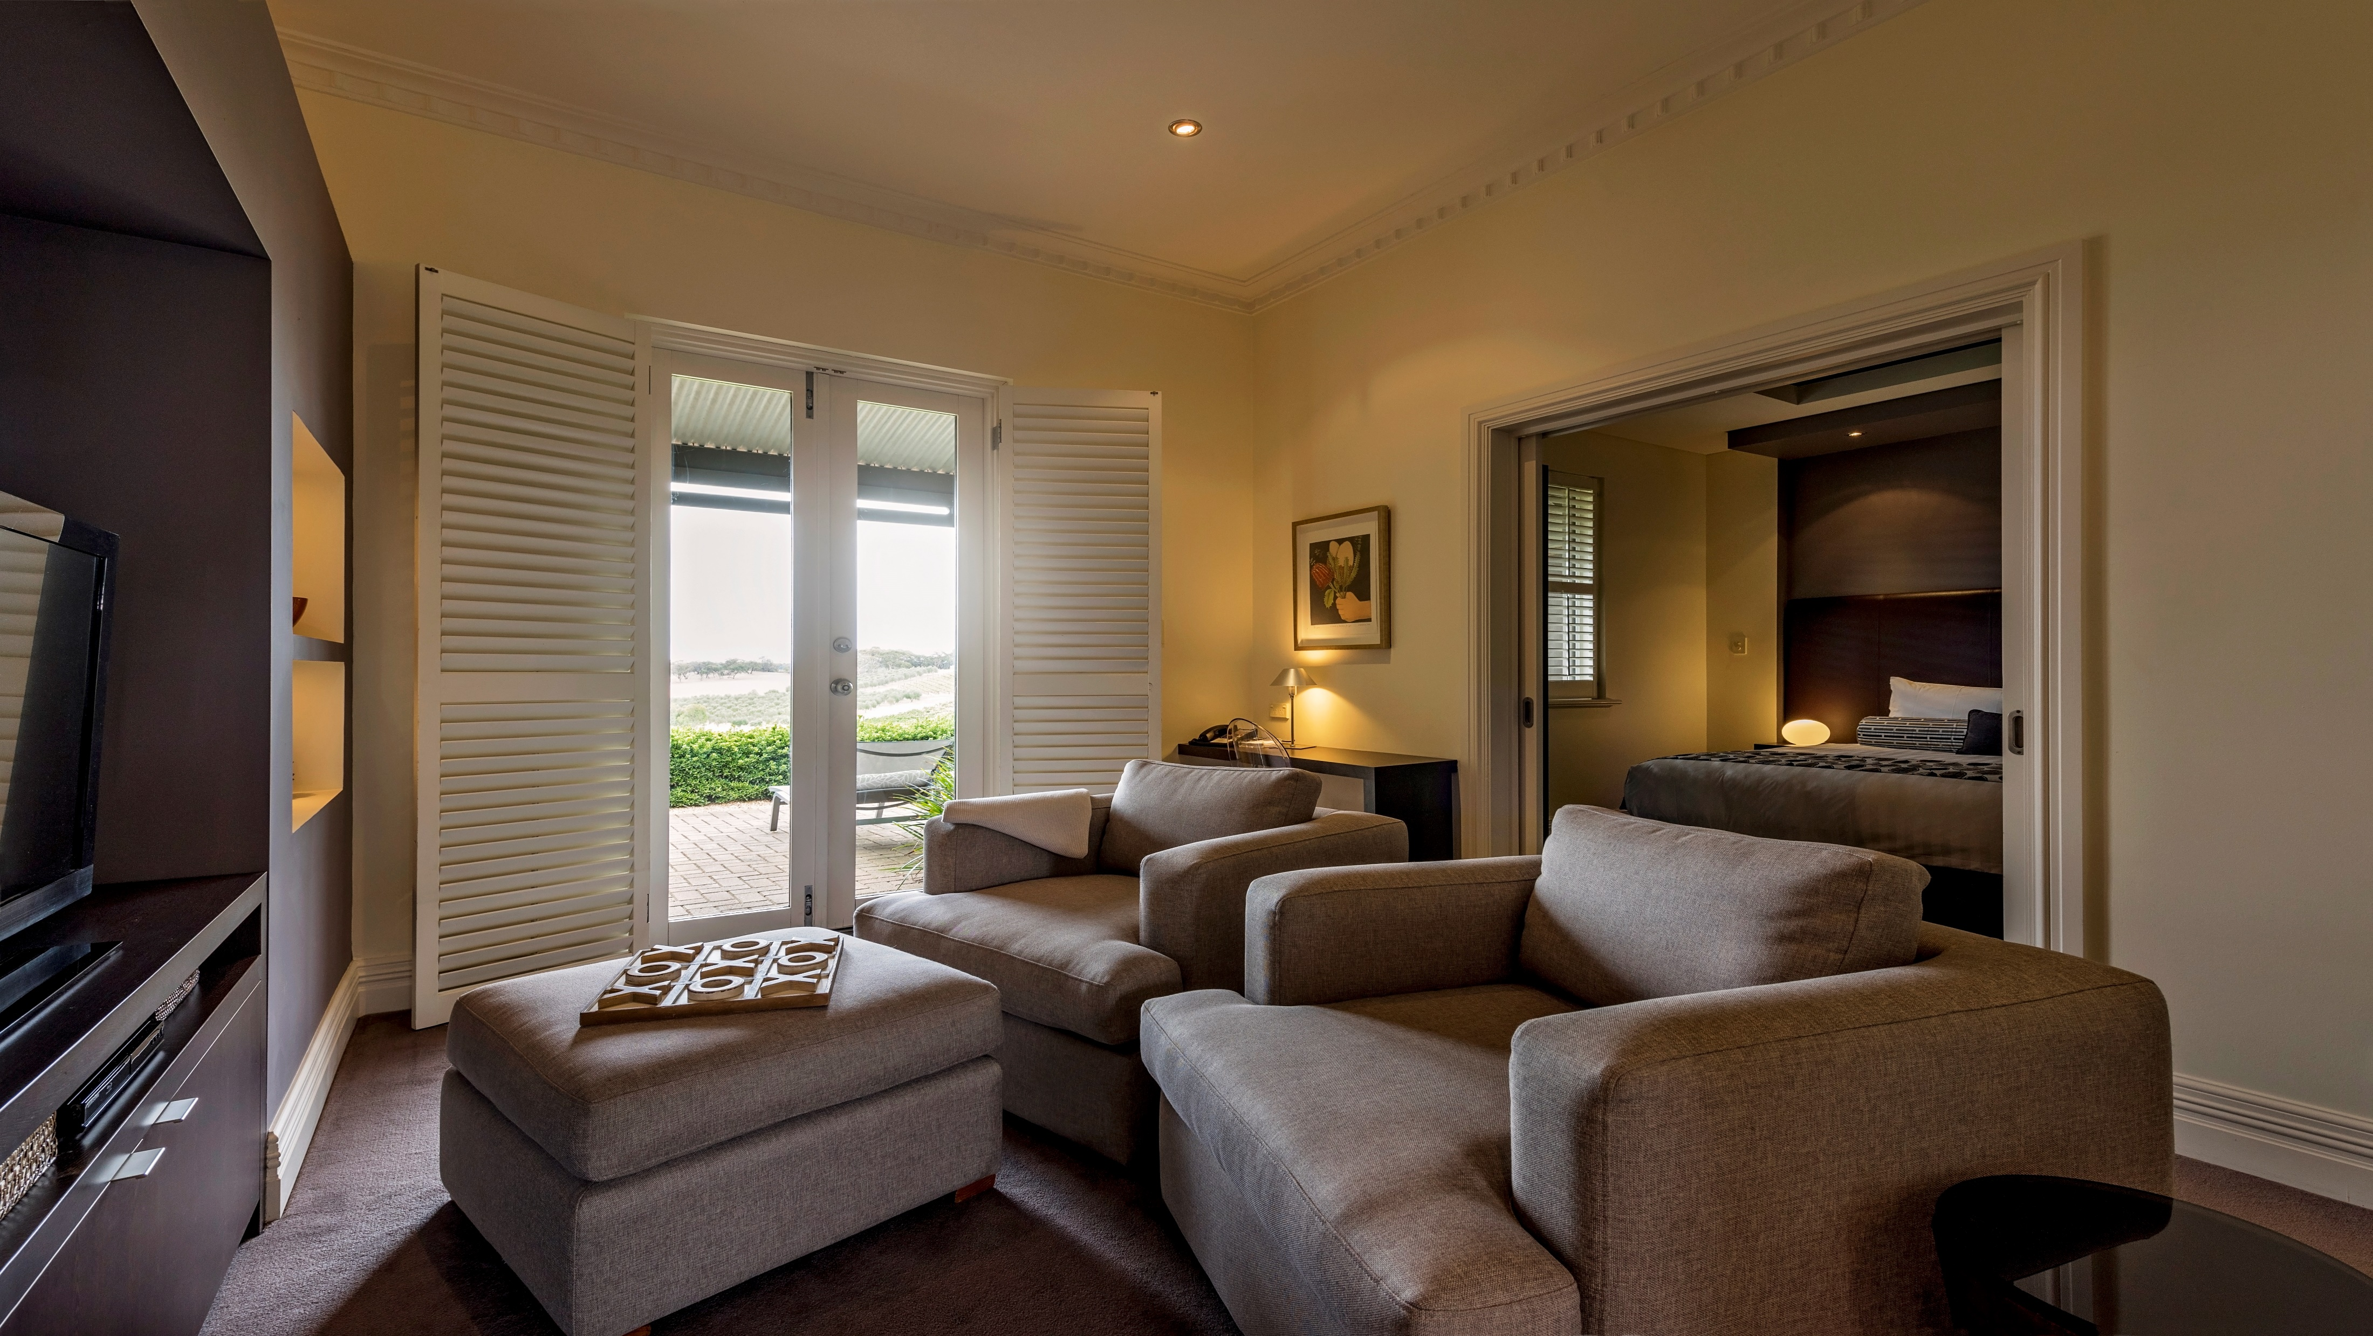
Ample space and contemporary design

Slide 5
Luxurious spa tubs and marble ensuites

Slide 6
Private terraces overlooking world famous vineyards

Slide 7
Relax by our infinity edge lap pool...

Slide 8
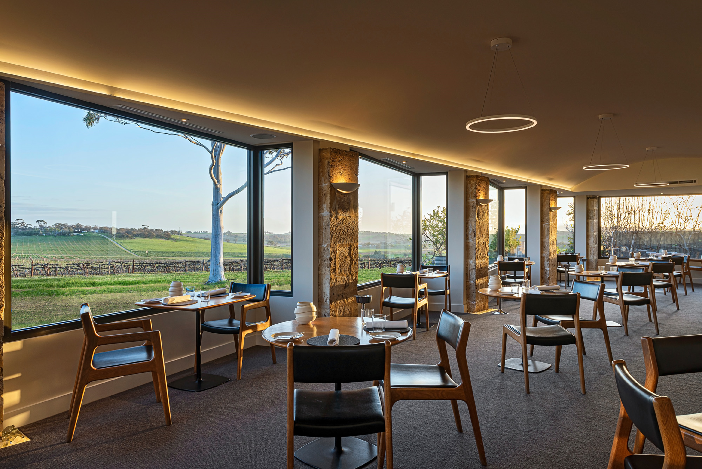
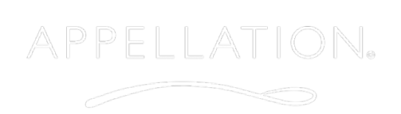
Newly renovated – August 2019

Slide 9
Fresh ingredients, straight from our kitchen garden, local producers and farm-gate suppliers

Slide 10
Award winning food and wine
Australia's Wine List of the Year Awards
Wine List of the Year South Australia “Hall of Fame” 2011 - 2019
Best Country Restaurant Wine List in Australia 2017
Wine Spectator Magazine
Wine List Best of Award of Excellence 2014 - 2019
Gourmet Traveller Restaurant Awards
Daniel Murphy, Executive Chef, Appellation
Best New Talent 2019 Finalist

Slide 12
Experience a very personal Barossa connection

Slide 13
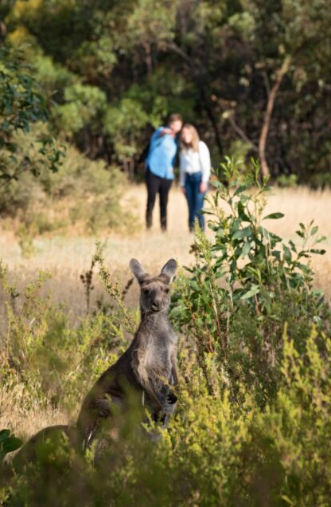
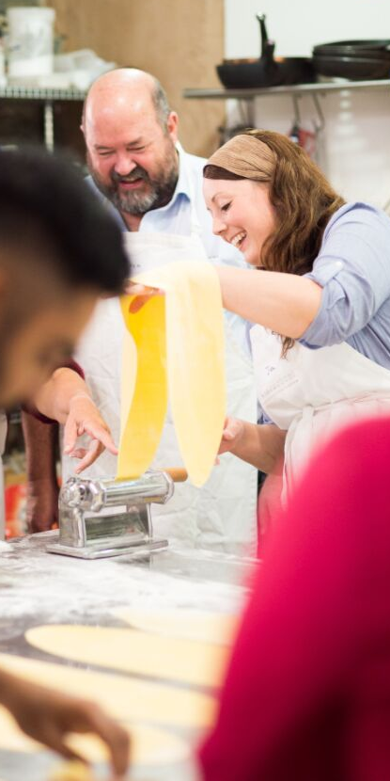
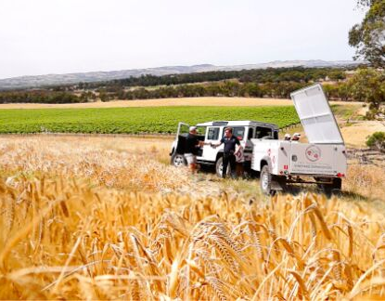
Discover the great vineyards of Barossa...
EXPERIENCE
Connect with the genuine culture of our region through a selection of experiences exclusive to guests of The Louise.
Or, allow our team to unlock the most 'off script' and custom experiences for your Barossa itinerary.
Have your breakfast with Kangaroos...
Become a winemaker for a day...

Slide 14
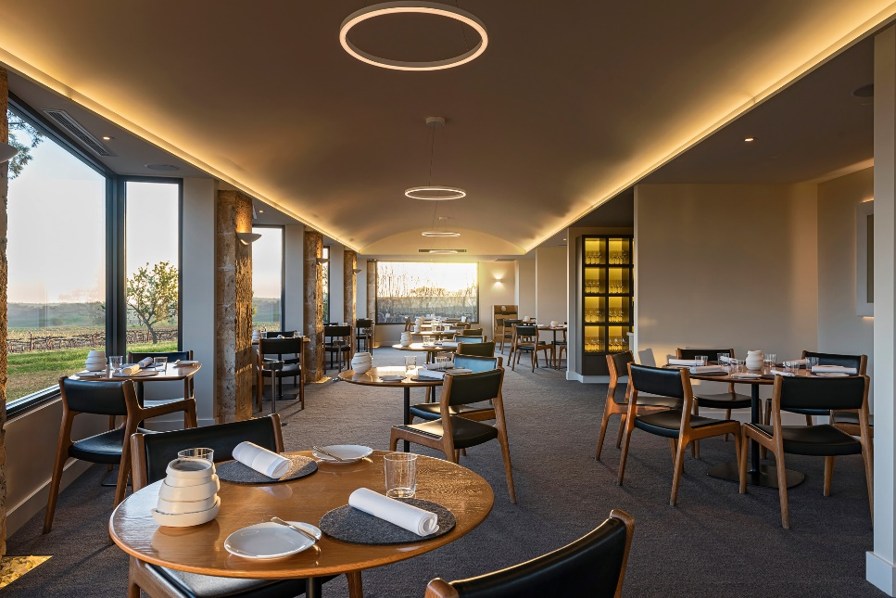
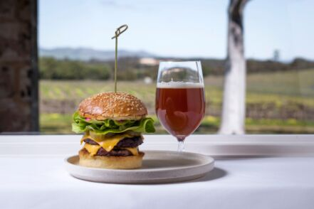
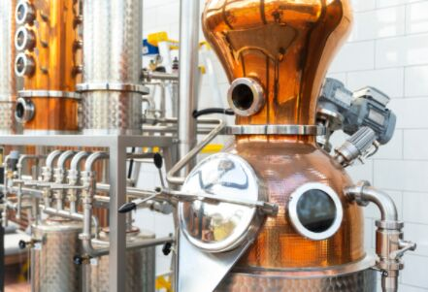
What's new at The Louise
Appellation Restaurant undergoes full renovation
The Louise to open new casual bar and kitchen
Brand new experiences for the perfect Barossa itinerary
The Louise's architects and builders have been busy this July... the team have used this winter break to renovate award winning restaurant, Appellation. A stylish upgrade awaits our guests as Appellation’s menu continues to raise the bar under the direction of Executive Chef, Daniel Murphy.
Following a major expansion this winter, The Louise will open a fresh new venue for upscale cocktails and satisfying comfort food overlooking a drop dead gorgeous view of the famous vineyard valley. The welcoming glass-walled, high ceiling bar is set to open early October 2019.
Gin blending at Seppeltsfield Road Distillers
Natural Perfume Masterclass at Vasse Virgin
Discover Harvest with Izway Wines - an exclusive backstage pass to a genuine Barossa Vintage

Slide 15
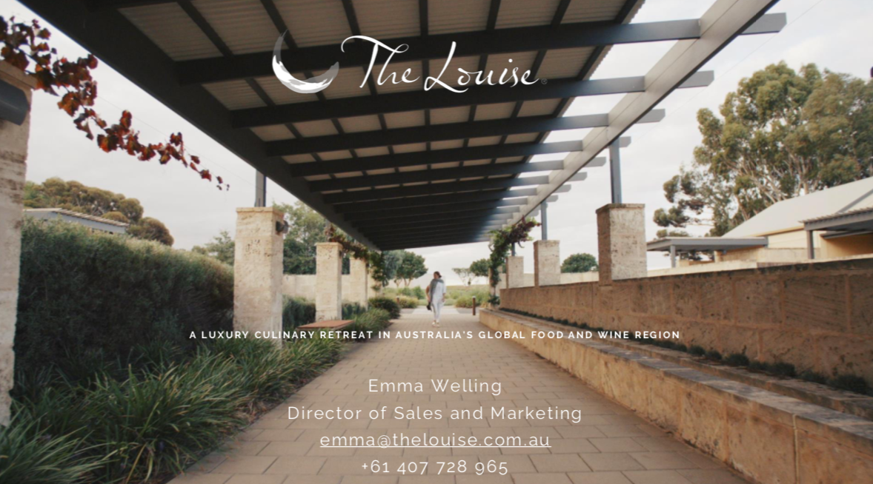
A LUXURY CULINARY RETREAT IN AUSTRALIA'S GLOBAL FOOD AND WINE REGION

